Slide 1
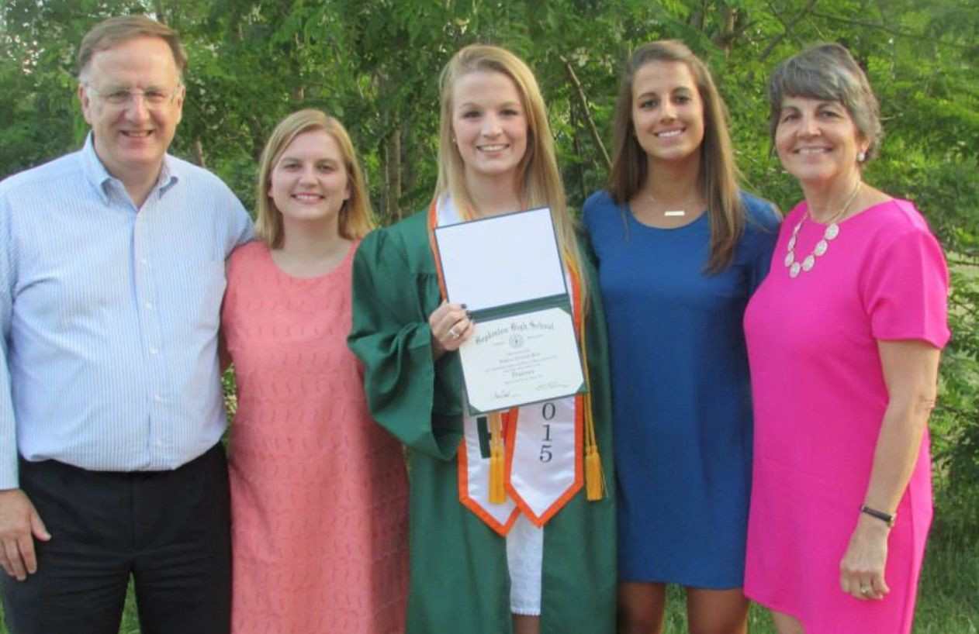
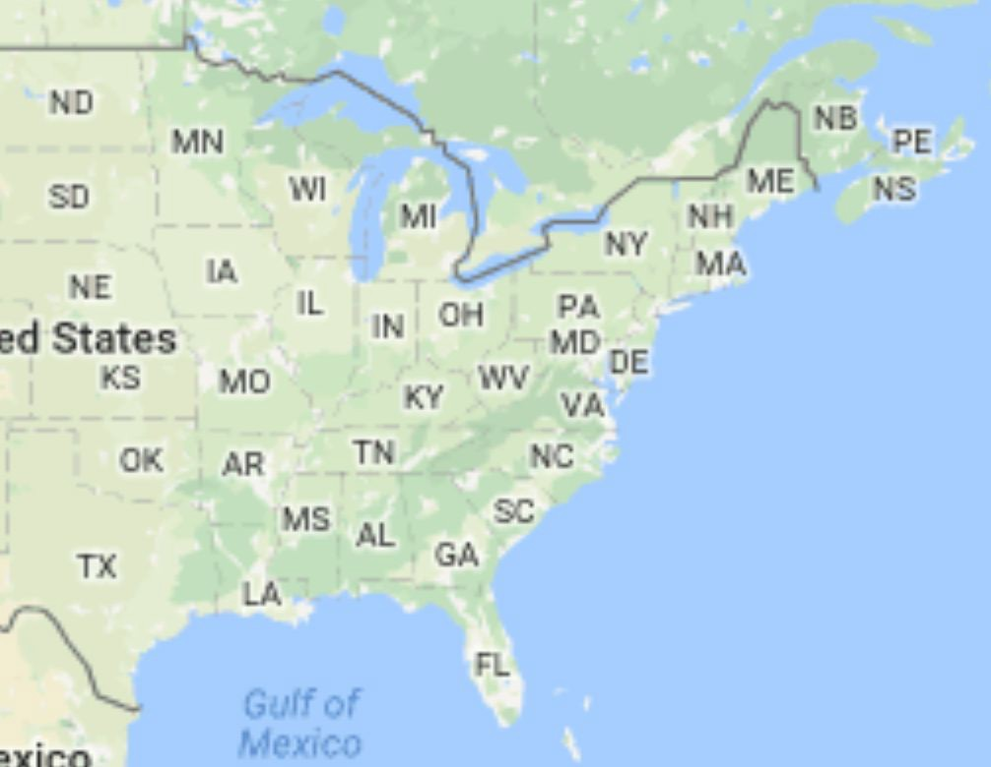
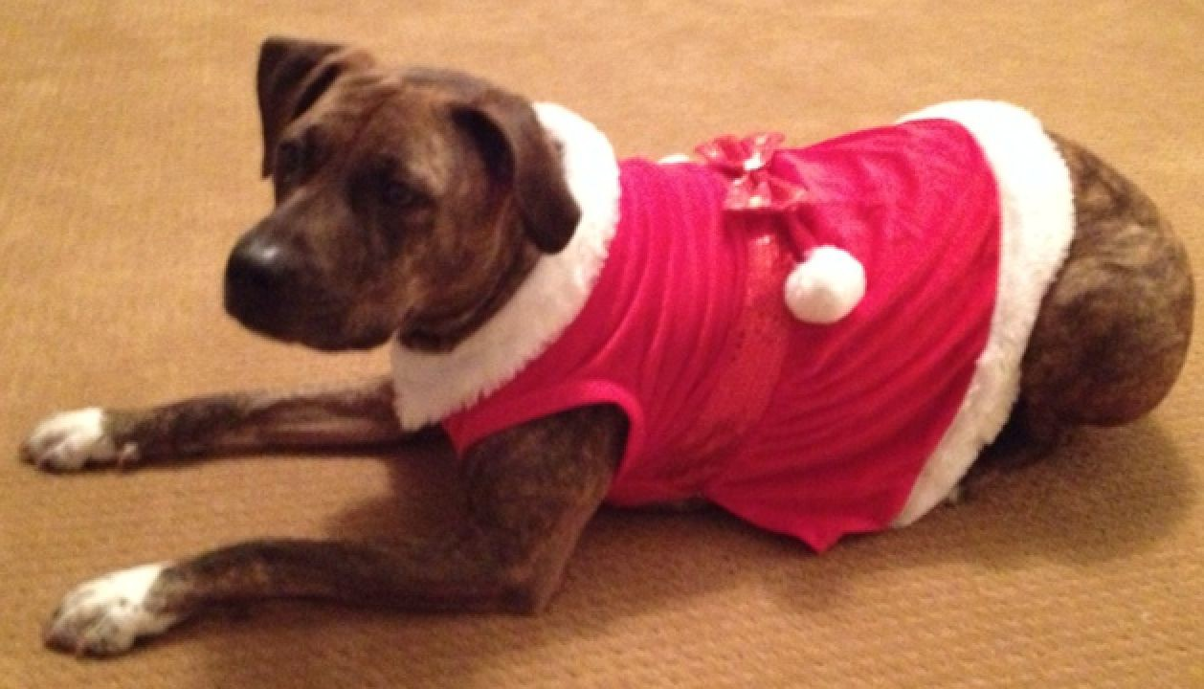

Lauren Blake
@Lauren_E_Blake

Slide 2
Human Health
Food
Genetics
Healthcare
Environ-ment

Slide 3
Which foods can help prevent urinary tract infections and how?
How do genetics influence susceptibility to yellow fever?
Given biological and clinical factors, can we make predictions about disease course in individuals with anorexia nervosa?
Human Health
Food
Genetics
Healthcare
Environ-ment

Slide 4
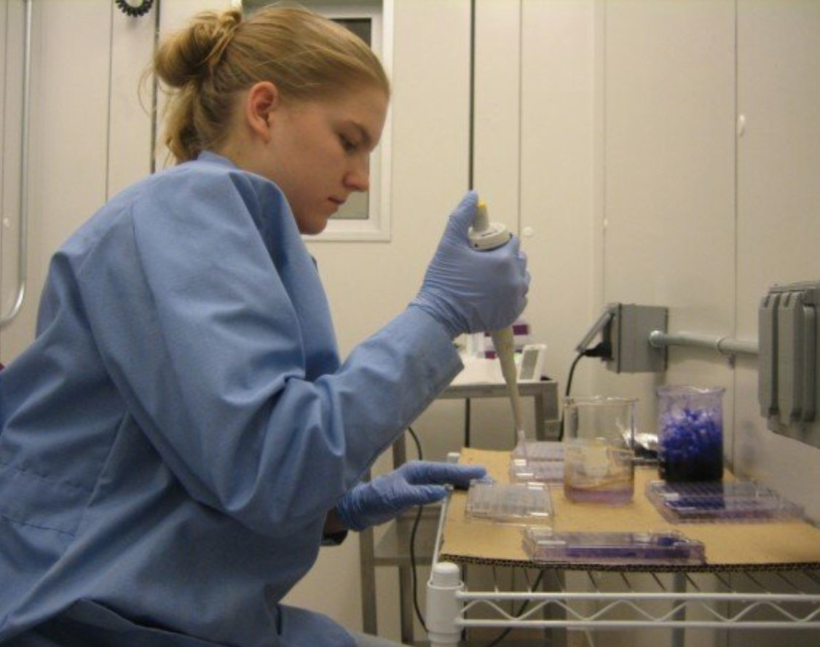
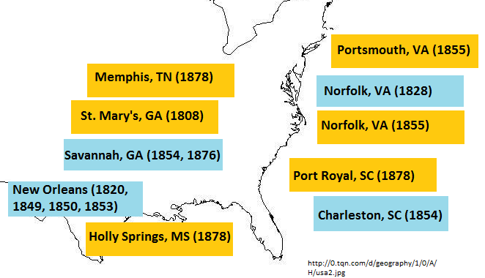
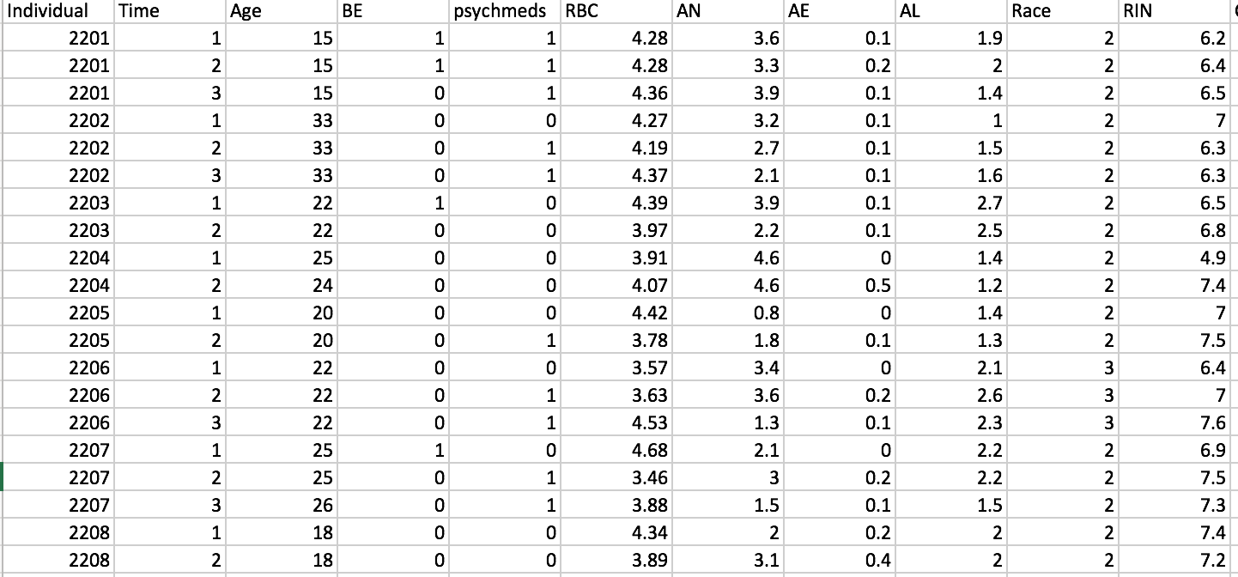
Which foods can help prevent urinary tract infections and how?
How do genetics influence susceptibility to yellow fever?
Given biological and clinical factors, can we make predictions about disease course in individuals with anorexia nervosa?

Slide 5

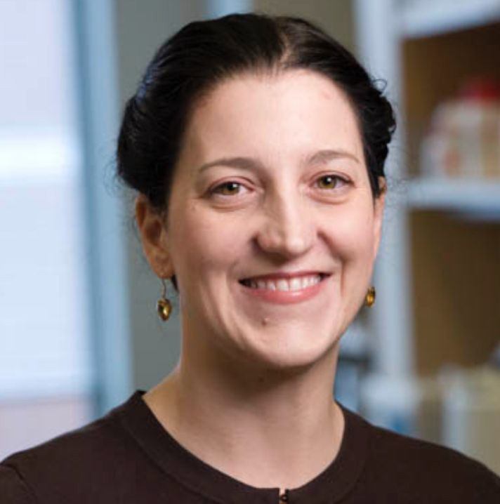

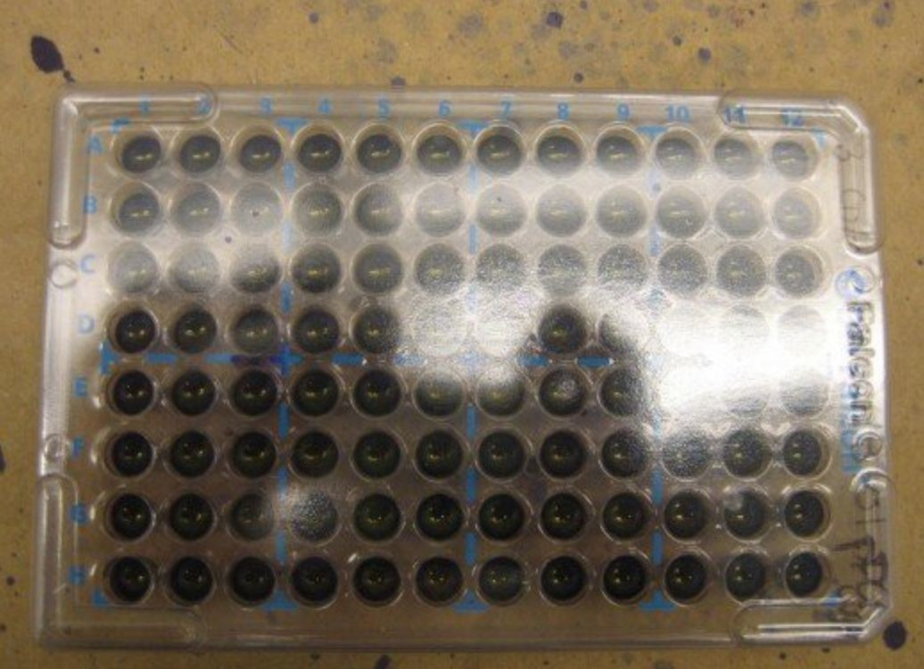
How does the food we eat impact our health?
Ms. Valerie Lechtanski Dr. Terri Camesano

Slide 6
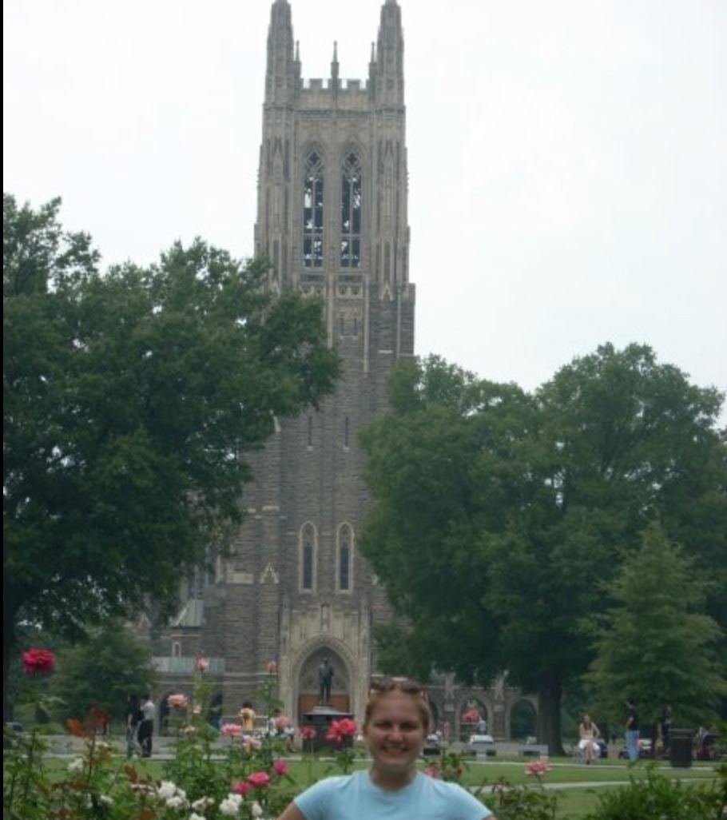
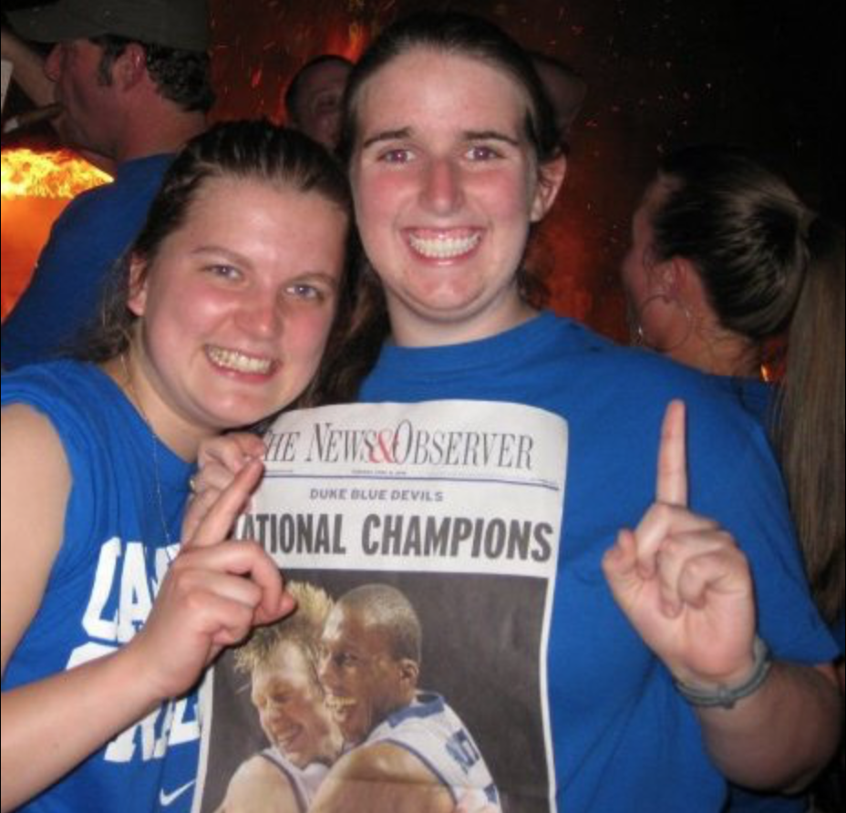

Slide 7
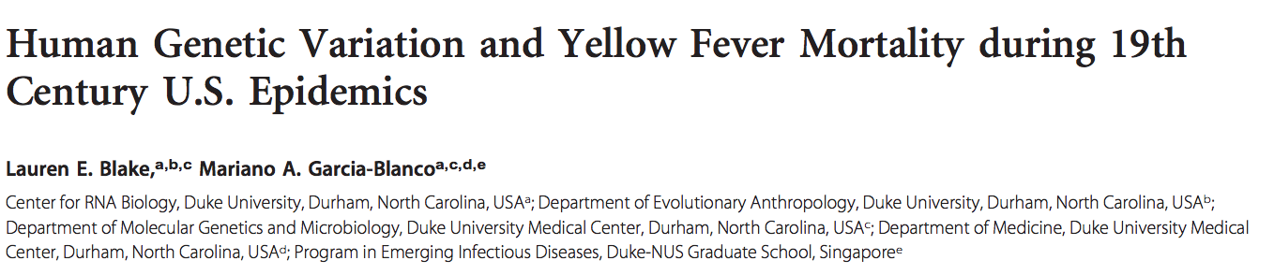
How does genetics influence disease susceptibility and severity?
The yellow fever case mortality rates demonstrate a skew toward populations of European ancestry that is stronger than other infectious diseases/causes of death at the time.

Slide 8
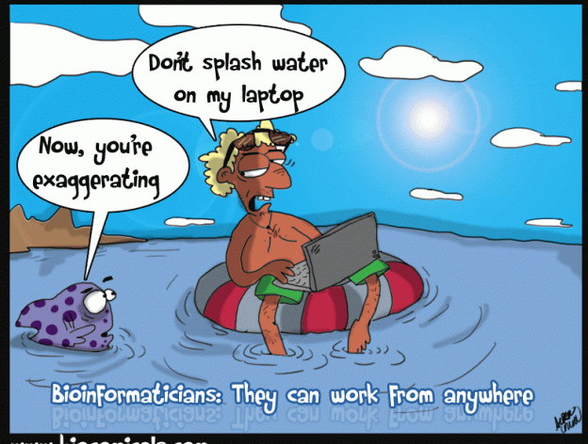

Slide 9


The genetic underpinnings of eating disorders
Eating disorders- Illnesses in which individuals experience severe disturbances in their eating behaviors, and related thoughts and emotions
Anorexia nervosa (AN)- Restriction of energy intake leading to a significantly low body weight; intense fear of gaining weight
Affect people of all genders, ages, races, ethnicities, body shapes and weights, sexual orientations, and socioeconomic statuses

Slide 10
Nutritional rehabilitation for individuals with AN
Hospital admission (60-70% of IBW) Hospital discharge (80-85% IBW)
Outpatient (100% IBW)
Goal: gain 1-2 pounds/week
Goal: gain 2-4 pounds/week
100% of IBW
Example: 5’6’’ woman
IBW: 130 pounds (117-143)
Most people admitted are 60-70% of IBW: 78-91 pounds
Most people are discharged 80-85% of IBW: 104-111 pounds
Ideal body weight: IBW

Slide 11
Nutritional rehabilitation for individuals with AN
Hospital admission (60-70% of IBW) Hospital discharge (80-85% IBW)
Outpatient (100% IBW)
Goal: gain 1-2 pounds/week
Goal: gain 2-4 pounds/week
100% of IBW
Example: 5’6’’ woman
IBW: 130 pounds (117-143)
Most people admitted are 60-70% of IBW: 78-91 pounds
Most people are discharged 80-85% of IBW: 104-111 pounds
35% of patients weight relapse post-discharge
Ideal body weight: IBW

Slide 12
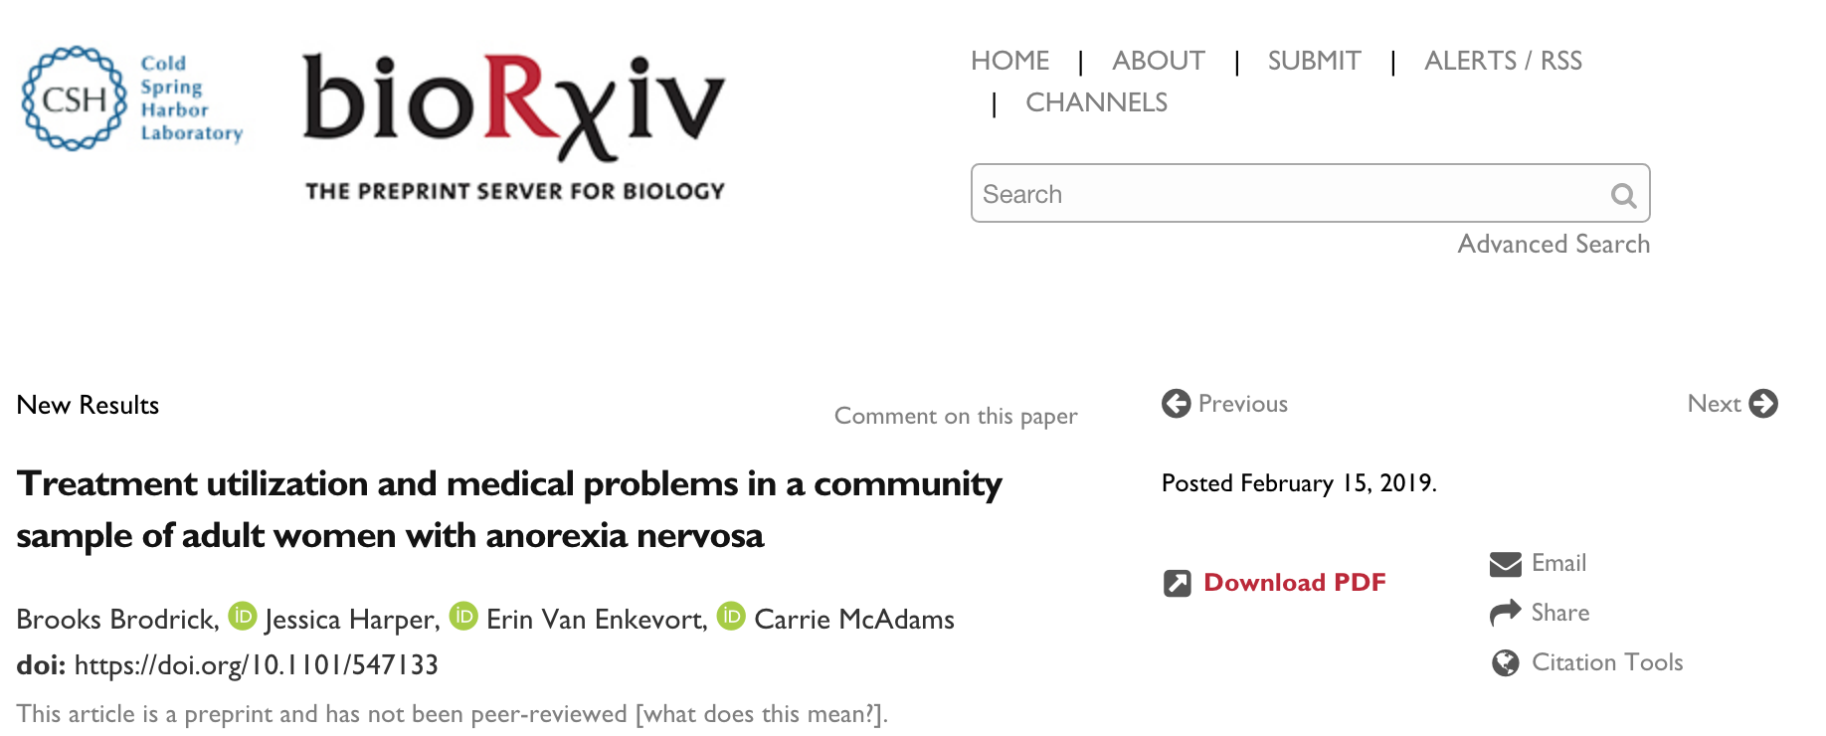
Identifying genes whose expression changes can help distinguish individuals at the highest risk for losing weight post-discharge (weight relapse)
Very challenging statistically

Slide 13
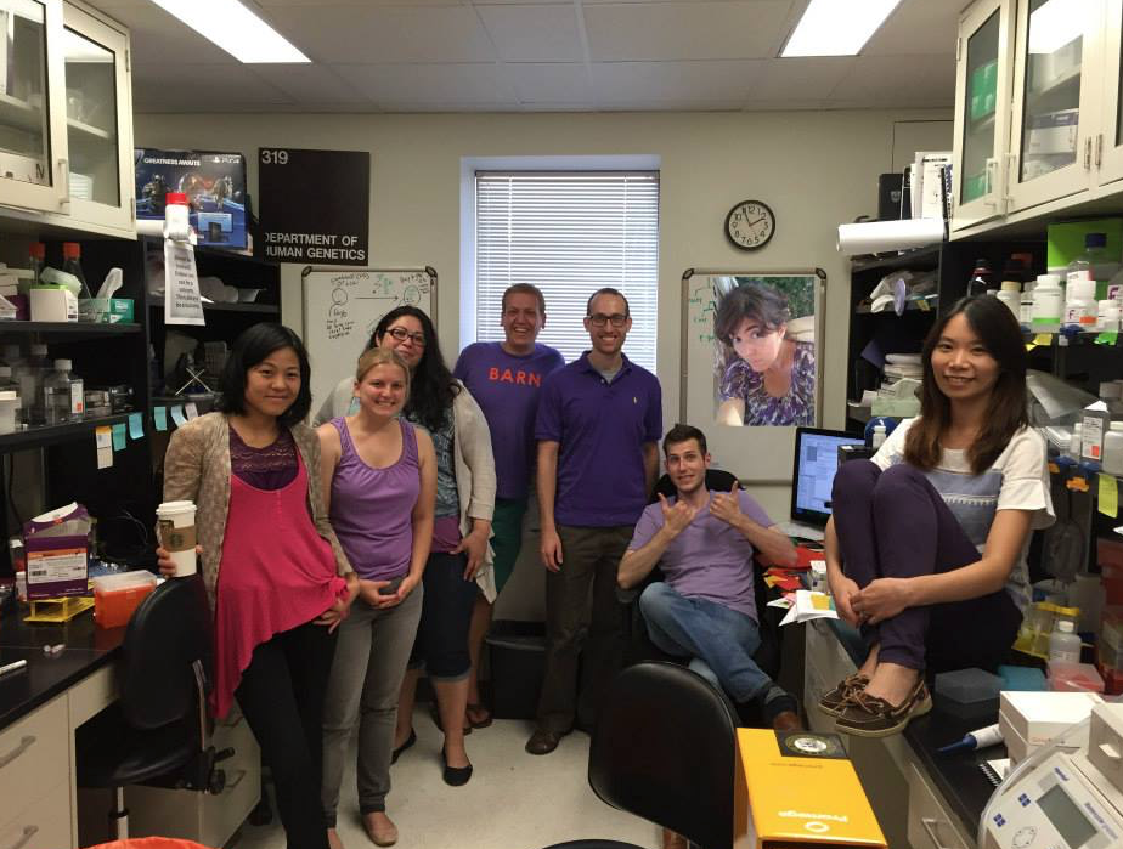
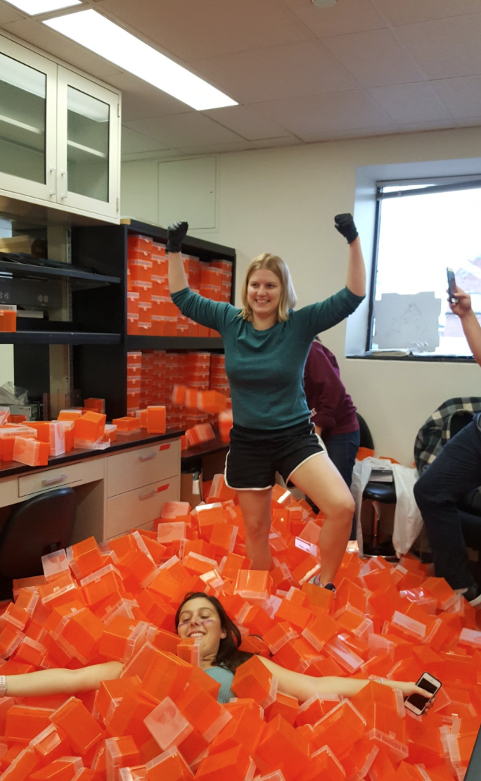
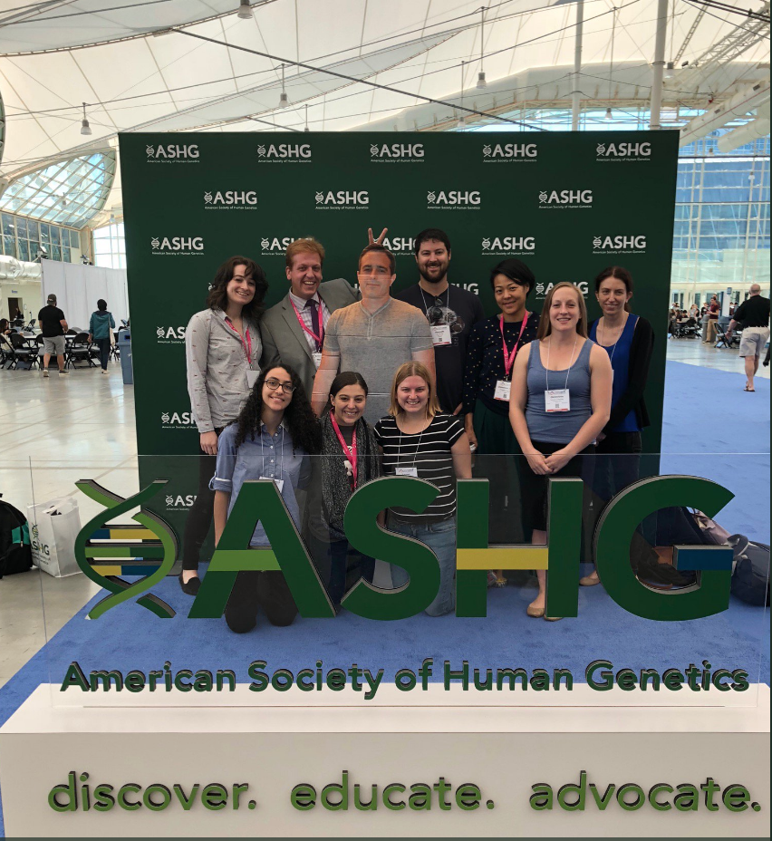
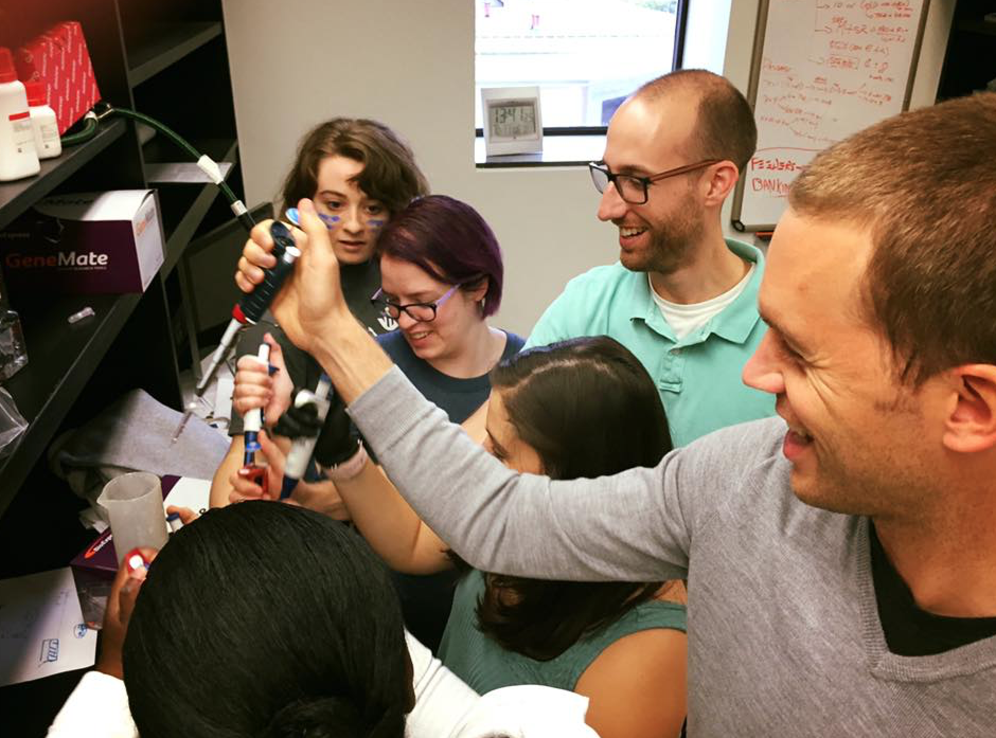
Even though coding can be hard, I get help from lots of great labmates/collaborators!

Slide 14
What do eating disorders and NASA have in common?

Slide 15
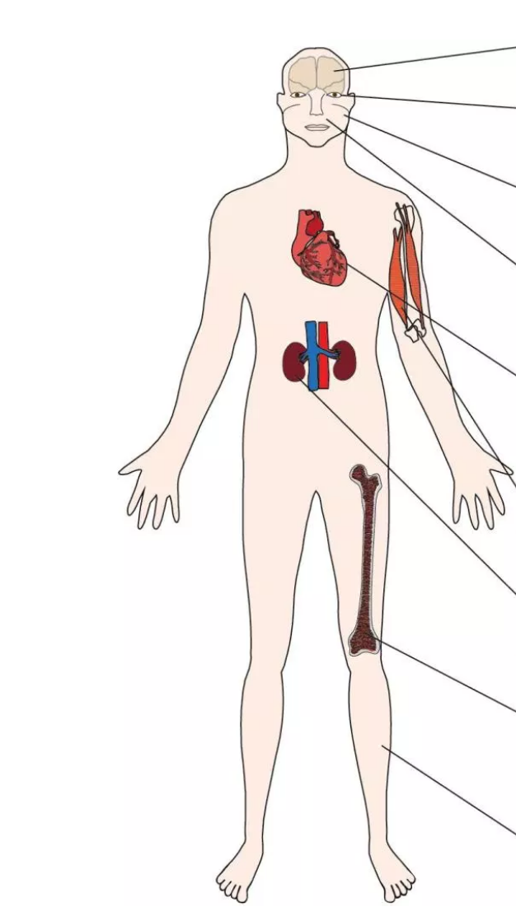
Consequences of space flight (microgravity) on humans

Slide 16
Consequences of space flight (microgravity) on humans overlap some of the medical consequences of anorexia nervosa

Slide 17
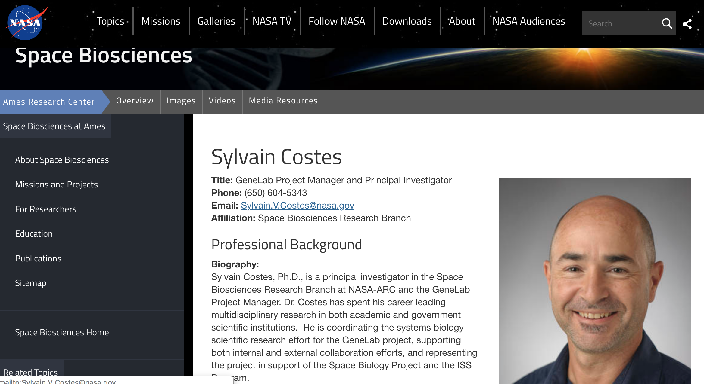
Unique problem common to both groups
Want to develop treatment that helps astronauts/individuals in the hospital increase muscle mass and bone density without burning a lot of calories

Slide 18
One of my collaborators

Slide 19
Astronaut Health
Food
Genetics
Healthcare
Environ-ment

Slide 20
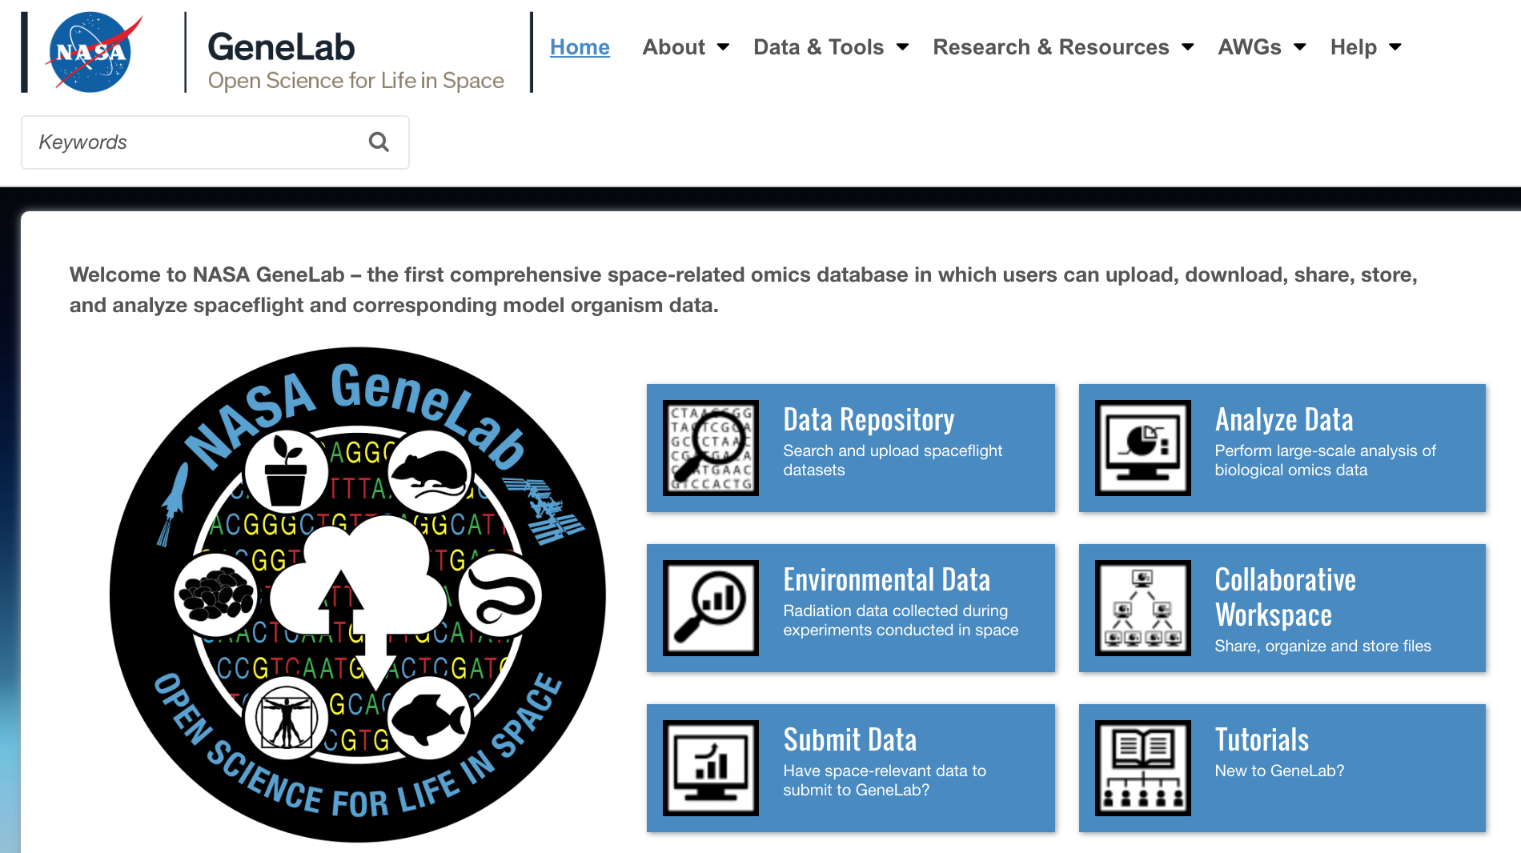

You also have access to NASA data!
https://genelab.nasa.gov/
https://data.nasa.gov/

Slide 21
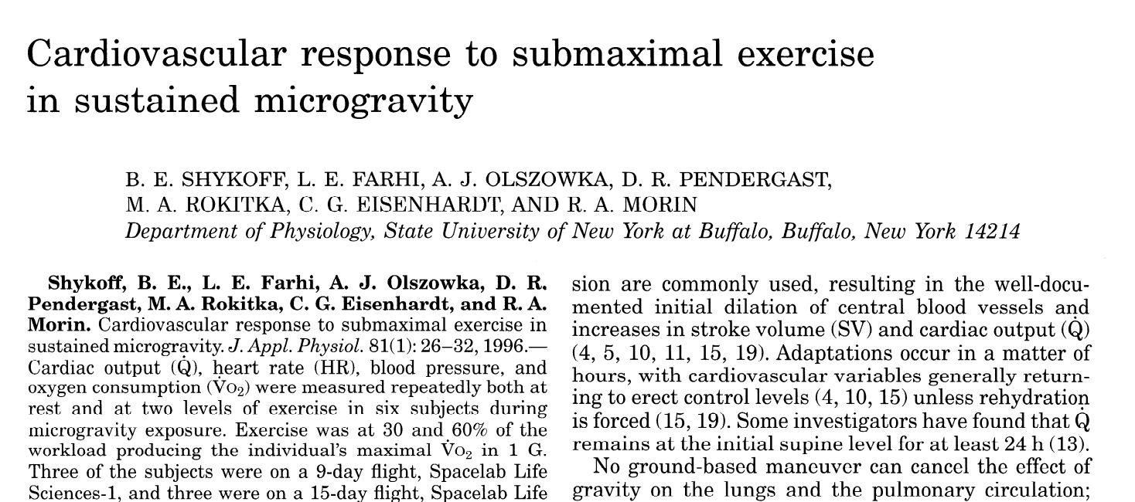
Activity using NASA data: What is the effect of space flight on human hearts?

Slide 22
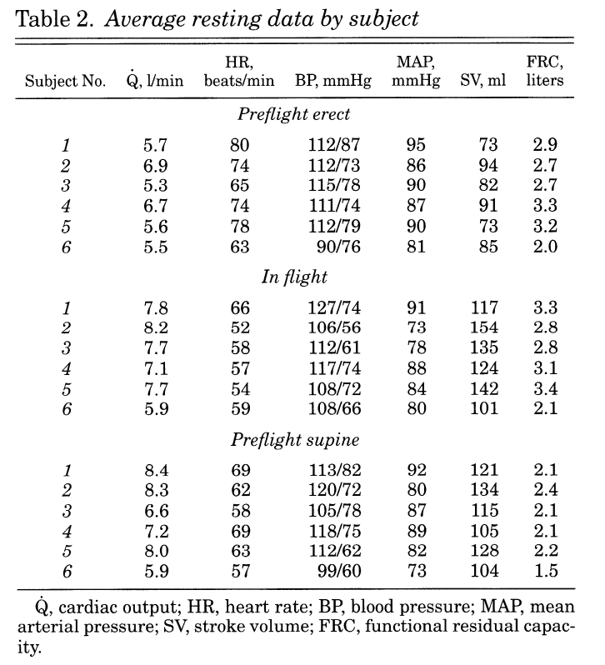
Astronauts that have been in flight for 9 or 15 days
Heart rate (HR)- measure of heart function and cardiovascular fitness
Mean arterial pressure (MAP)- average pressure in a patient’s arteries during one cardiac cycle
Stroke volume (SV)- volume of blood pumped from the left ventricle per beat.
Functional residual capacity (FRC)- volume of air present in the lungs at the end of passive expiration.
Cardiac output (Q)- is the product of the heart rate (HR), or the number of heart beats per minute (bpm), and the stroke volume (SV)

